Slide 1
Edge Computing
Lecture 9: Ethics, Privacy & Security

Slide 2
Recap
Paper presentations
○ + diverse topics,
Workout detection, agriculture, smarthome, etc.
○ + going above and beyond the class,
CNN, FedML, LSTM, TinyML, Efficient ML, etc.
○ + good practice of getting to know the topic/field you are working on
use as reference, baseline for comparison in your final project
○ + presentation skills
volume, pace, clarity, animation, flow, timing

Slide 3
Agenda
Ethics
ACM, IEEE, code of conduct
Privacy & Security
GDPR
CCPA

Slide 4
ACM Code of Ethics and Professional Conduct
ACM: Association for Computing Machinery
Largest scientific and educational computing society (they have student memberships ;-) )
IEEE: Institute of Electrical and Electronics Engineers
Largest technical professional organization dedicated to advancing technology for the benefit of humanity (they have student memberships too ;-) )
“The Code is designed to inspire and guide the ethical conduct of all computing professionals, including current and aspiring practitioners, instructors, students, influencers, and anyone who uses computing technology in an impactful way.”
ACM Code of Ethics and Professional Conduct
IEEE Code of Conduct

Slide 5
Ethical Principles
Contribute to society and to human well-being, acknowledging that all people are stakeholders in computing.
Avoid harm
Be honest and trustworthy
Be fair and take action not to discriminate
Respect the work required to produce new ideas, creative works, and computing artifacts
Respect privacy
Honor confidentiality

Slide 6
Example
Say you are given the task of designing a security system that will detect if a person whose face matches a face from a criminal database. The system will have several cameras and send the information to a cloud server. The user will receive a report and video of people had positive matches.
Which codes could be broken and how can you mitigate it?

Slide 7
Privacy & Security
Security has a broad meaning within computer science. For this scope we focus on personal data security, keeping personal data secured
Privacy is the ability of an individual or group to seclude themselves or information about themselves, and thereby express themselves selectively.

Slide 8
The Law
Unlike a Code of Ethics, privacy and security are required and guidelines by law and therefore enforceable.
LAW
EU General Data Protection Regulation (GDPR)
California Consumer Privacy Act (CCPA)

Slide 9
General Data Protection Regulation (GDPR)
Implemented in 2018, its objectives are:
Modernize EU’s legal system in response to new technologies
Strengthen the user’s data ownership
Improve the clarity and coherence of current rules
EU Law?
GDPR applies for any business that interacts with EU residents regardless of origin
It establishes a framework and design requirements from early phases of development
Countries rapidly implemented their own regulation modeled after GDPR

Slide 10
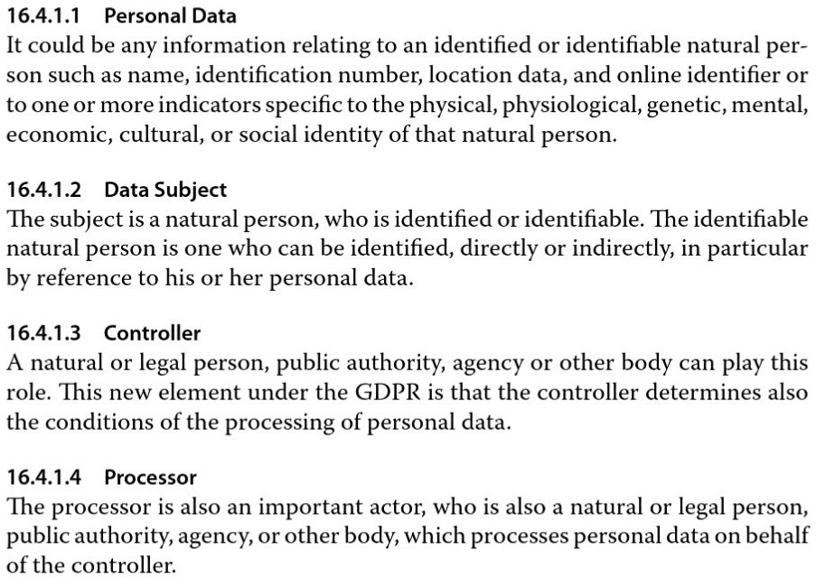
Terms in GDPR
Personal Data
Data Subject
Controller
Processor
Fog and Edge Computing: Principles and Paradigms, Chapter 16

Slide 11
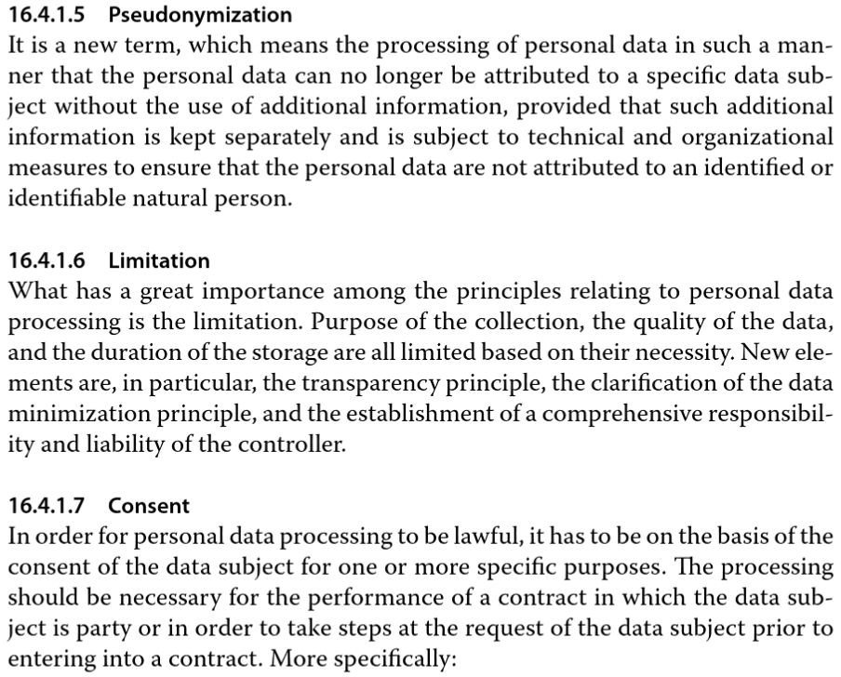
Terms in GDPR
Pseudonymization
Limitation
Consent
Fog and Edge Computing: Principles and Paradigms, Chapter 16

Slide 12
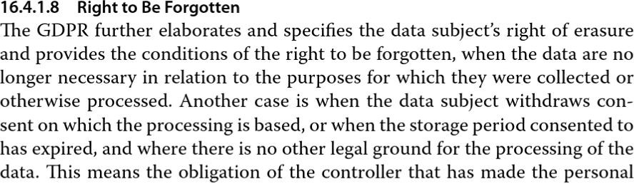
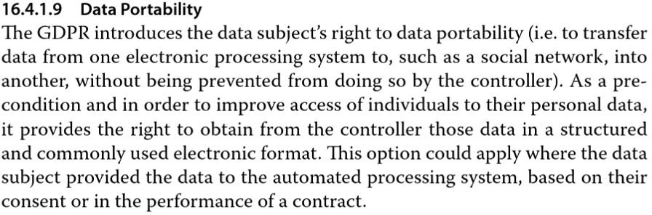
Terms in GDPR
Right to be forgotten
Data Portability
Fog and Edge Computing: Principles and Paradigms, Chapter 16

Slide 13
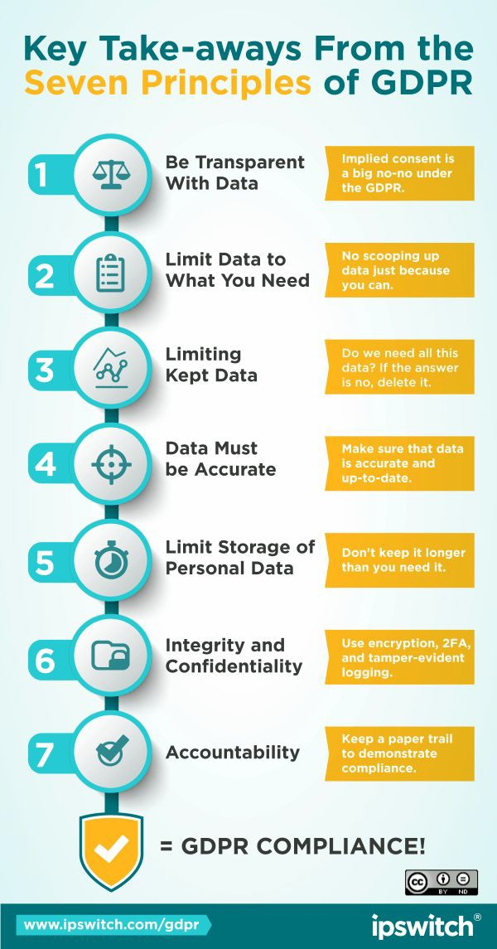
GDPR Principles
Transparent processing
Limitation of collected data
Minimize collected and stored data
Personal data must be accurate
Limit storage of personal data
Integrity and confidentiality
Accountability
https://www.progress.com/blogs/gdpr-eu-personal-data

Slide 14
GDPR Obligations
The controller must identify itself, the purpose of data collection and all parties that will have contact with it
The processor must only act under the controller’s supervision and under strict confidentiality, and have a mechanism for data deletion at the controller’s demand
Both work together to ensure compliance
Any security breach or risk of breach must be communicated to the Data Subject within 72 hours

Slide 15
GDPR Impact
Meta
Charged $1.5B from nine cases
Data collection practices
Mishandling children’s data
Leaks…
Tiktok
Charged $16.7M
Amazon
Charged 748M euros
Google
Charged 216M euros
https://observer.com/2023/05/gdpr-europe-meta-fines/

Slide 16
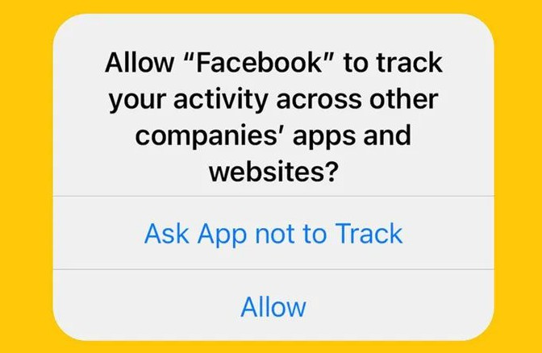
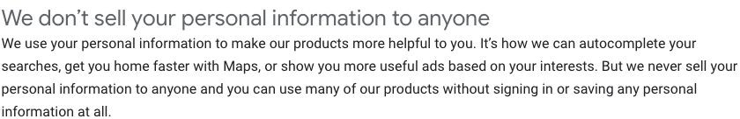
GDPR Impact
Some free services profit from data
Selling personal data
Targeted advertising
Google’s statement

Slide 17
California Consumer Privacy Act (CCPA)
Signed a month after GDPR’s implementation, went into effect on January 1st, 2020.
There are a lot of ideological similarities with GDPR, though the way they are implemented are slightly different
Note that businesses that interact with residents of California, and the EU, must abide to both laws

Slide 18
GDPR vs CCPA: Key Differences
CCPA adds the following as some of the key differences to GDPR:
The subject has a right to know and access all the data is being collected from them
At any time, the subject can opt-out from selling or profiting from their information
Services must be equal regardless of consent
Users 13-16 must provide consent while users under 13 require the parent’s consent
Only businesses that earn $25 MIL or more, has more than 50k consumers, or more than 50% of their profit comes from selling information, must comply

Slide 19
Summary
Ethics
ACM, IEEE, code of conduct
Privacy & Security
GDPR
CCPA

Slide 20
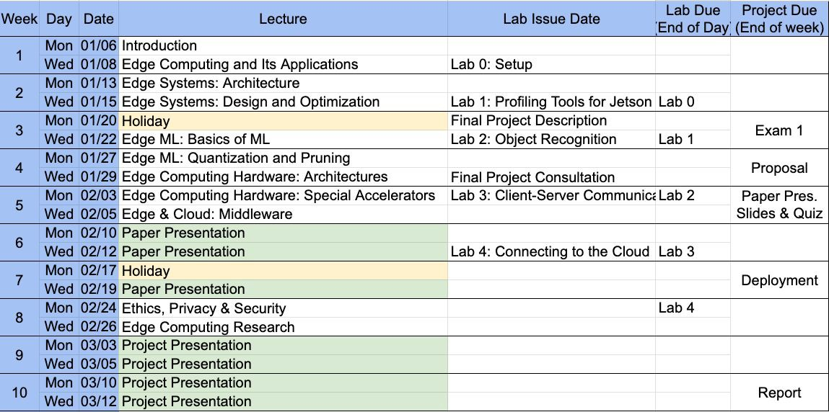

Slide 21
Next Lectures
Guest lecture(s)
Final presentations
Week 9-10

